Slide 1
Ukrainian advocates
Learning best practices of working with international clients
Lecture & Workshop at UNBA
September 11, 2018
Alfred F. Praus
11.09.2018 Kyiv

Slide 2
UKRAINIAN-AUSTRIAN ASSOCIATION
Non-profit, non-political. Established in 2017 in Kyiv
Open for institutions, businesses and individuals interested in bilateral relations.
Mission:
Strengthening social, civil, cultural, and business ties between Ukraine and Austria and beyond through bilateral initiatives and projects
Contacts: Kyrylivska Str. 1-3, 04080 Kiev/Ukraine
www.ukrainian-austrian-association.com
info@ukrainian-austrian-association.com
11.09.2018 UNBA Kyiv

Slide 3
Alfred F. Praus
Austrian, MBA, since 12 years in Ukraine
30 years of business experience worldwide: controller, M & A, strategic planning, Managing Director & Chairman of Board of Directors of multinational groups heading 1,000 people
Ukraine : Managing Director of 2 companies, Management Consulting Kiev – Vienna
President of Ukrainian-Austrian Association (2017)
11.09.2018 UNBA Kyiv

Slide 4
Lawyers in Cross-cultural Business
There is no business without legal issues.
Business interests must have priority over one-sided legal consideration.
A good lawyer thinks and acts like a business person.
In international business, the mentality and business thinking of an international partner has to be taken into account in every case.
Therefore, lawyers in business have to understand and consider cultural differences.
11.09.2018 UNBA Kyiv

Slide 5
Why Business Under Intercultural Management Aspects?
Association Agreement EU-Ukraine
Prosperity requires growth
Growth requires foreign investment
Foreign investment requires:
Rule of law, law enforcement, etc.
“Western” norms and standards
Speaking the same “language”
Success in International business requires professional approach and respect for the Western values
11.09.2018 UNBA Kyiv

Slide 6
WHAT IS CULTURE?
A system of values and beliefs which we share with others, all of which gives us a sense of belonging or identity.
MAIN ELEMENTS OF CULTURE
Language
Symbols
Religion
History & Traditions
Norms
Values
Beliefs
Cognitive Elements
11.09.2018 UNBA Kyiv

Slide 7
Why do Cultures Differ?
History
Educational Backgrounds
Social Backgrounds
Ethnic
Religion
Ecology
Technology
11.09.2018 UNBA Kyiv

Slide 8
Cultural Iceberg
11.09.2018 UNBA Kyiv

Slide 9
It Is All About Values
Cultural Values
Values are important and lasting beliefs or ideals shared by the members of a culture about what is good or bad and desirable or undesirable.
support for democracy
tolerance of foreigners and ethnic minorities
support for gender equality.
the role of religion and changing levels of religiosity
the impact of globalization
Attitudes: environment, work, family, politics, national identity, culture, diversity and subjective well-being.
Personal Values
Values have major influence on a person's behavior and attitude and serve as broad guidelines in all situations.
Internal reference for what is good, beneficial, important, useful, beautiful, desirable and constructive
11.09.2018 UNBA Kyiv

Slide 10
Personal Values
Accountability Accuracy Achievement Adventurousness Altruism Ambition Assertiveness Balance Being the best Belonging Boldness Calmness Carefulness Challenge Cheerfulness Clear-mindedness Commitment Community Compassion Competitiveness Economy Effectiveness | Efficiency Elegance Empathy Enjoyment Enthusiasm Equality Excellence Excitement Expertise Exploration Expressiveness Faith Fidelity Fitness Fluency Focus Consistency Contentment Continuous Improvement Contribution Control | Cooperation Correctness Courtesy Creativity Curiosity Decisiveness Dependability Determination Devoutness Diligence Discipline Legacy Love Loyalty Making a difference Mastery Merit Obedience Openness Order Originality Patriotism Perfection | Piety Positivity Practicality Preparedness Professionalism Prudence Quality-orientation Reliability Resourcefulness Restraint Results-oriented Security Self-actualization Self-control Selflessness Discretion Diversity Dynamism Freedom Fun Generosity Goodness Grace Growth | Happiness Hard Work Health Helping Society Holiness Honesty Honor Humility Independence Inner Harmony Inquisitiveness Insightfulness Intelligence Intellectual Status Intuition Joy Justice Leadership Self-reliance Sensitivity Serenity Service Shrewdness Simplicity | Soundness Speed Spontaneity Stability Strategic Strength Structure Success Support Teamwork Temperance Thankfulness Thoroughness Thoughtfulness Timeliness Tolerance Traditionalism Trustworthiness Truth-seeking Understanding Uniqueness Unity Usefulness Vital
11.09.2018 UNBA Kyiv

Slide 11
Dimensions of Diversity
AGE
RACE
NATIONALITY
CLASS
GENDER
DISABILITY
ETHNICITY
SEXUAL ORIENTATION
RELIGION
11.09.2018 UNBA Kyiv

Slide 12
Culture Shock in Action
11.09.2018 UNBA Kyiv

Slide 13
Constituent Elements of Intercultural Competence
(adapted from Deardorff, 2006)
11.09.2018 UNBA Kyiv

Slide 14
11.09.2018 UNBA Kyiv

Slide 15
11.09.2018 UNBA Kyiv

Slide 16
11.09.2018 UNBA Kyiv

Slide 17
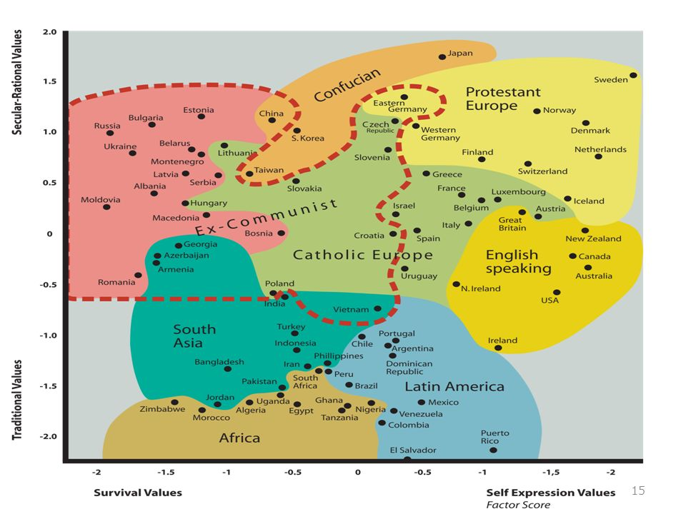
Inglehart–Welzel Cultural Map of the World
11.09.2018 UNBA Kyiv

Slide 18
Elements of Intercultural Communication
Cultural differences can extend themselves to:
the way in which people of different cultures address each other
what level of formality or informality makes people comfortable
non-verbal behavior, eye contact, hand gestures, physical proximity, etc.
personal grooming such as dress code and hygiene issues.
Cultural elements affecting the outcome of intercultural communication
Verbal Processes
Non-Verbal Processes
Perception
11.09.2018 UNBA Kyiv

Slide 19
Ideal World vs Living Hell
In an ideal world ...
• the policemen would be English
• the car mechanics would be German
• the cooks would be French
• the innkeepers would be Swiss,
• and the lovers would be Italian
In a living hell ...
• the policemen would be German
• the car mechanics would be French
• the cooks would be English
• the innkeepers would be Italian
• and the lovers would be Swiss
11.09.2018 UNBA Kyiv

Slide 20
Non-Verbal Communication “Listen With Your Eyes”
Posture
Clothing
Gestures
Distance / Space
Eye Contact
Movement & Body Position
Touch
Voice / Paralinguistic
Accounts For 60-80 % of Communication
11.09.2018 UNBA Kyiv

Slide 21
Non-Verbal Communication: Keep the Right Distance
11.09.2018 UNBA Kyiv

Slide 22
Ten Cultural Value Differences (Hofstede et al.)
Individualism vs Collectivism
Power Distance
Uncertainty Avoidance
Orientation to Time
Gender Egalitarianism
Assertiveness
Being vs Doing
Humane Orientation
Indulgence vs Restraint
Performance Orientation
11.09.2018 UNBA Kyiv

Slide 23
Anglo-EU Translation Guide
11.09.2018 UNBA Kyiv

Slide 24
Culture Affects International Business in Three Core Areas
Communication
risk of your message getting “lost in translation”
English is the de facto language of business
non-verbal communication
Organizational hierarchy
Clan Culture
Adhocracy Culture
Market Culture
Hierarchy Culture
Workplace etiquette
formality of address
punctuality
differences in attitude towards work
11.09.2018 UNBA Kyiv

Slide 25
Guidelines for Bridging the Gap Between Different Cultures
Seek information about the culture
Be other-oriented
Ask questions
Develop mindfulness
Develop flexibility
Tolerate ambiguity
Avoid negative judgments
11.09.2018 UNBA Kyiv

Slide 26
Why Many International Mergers and Acquisitions Fail: It’s the Culture, Stupid!
Intercultural risks and opportunities in the integration process underestimated
Basic elements of workplace behavior diverging
Lack of intercultural due diligence and planning → major misunderstandings
No careful consideration how the culture (of the newly combined organizations) should evolve
The benefits of cross-border M&As are not outweighing the challenges
Lack of intercultural awareness and planning often leads to poor performance of these integrated organizations
11.09.2018 UNBA Kyiv

Slide 27
Failure of Mergers
KPMG (2017): The majority of company mergers fail to add shareholder value
EIU & Mercer (2008): the two most transaction challenges are cultural differences and human capital integration issues
Three Examples
Daimler Benz and Chrysler (1998)
Bank of America and Merrill Lynch (2009)
Volvo and Renault (1993)
11.09.2018 UNBA Kyiv

Slide 28
Some Practical Examples of Cultural Misunderstandings
From 30 Years of Business Travel
Around the World
11.09.2018 UNBA Kyiv

Slide 29
Americans/Key Values
Individualism and Privacy
Equality
Informality
Future, Change, Progress
Work
Goodness of Humanity
Time
Achievement, Action
Materialism
Directness, Assertiveness
11.09.2018 UNBA Kyiv

Slide 30
Cultural Contrasts
 | The United States | Russia
Authority | Diffused from people, flows up | Centralized, flows down
Change | From below, individual | Imposed from above, society
Rights | Celebrated, protected | Subordinated for communal good
Diverse Views | Tolerance, pluralism | Consensus, single truth
Economy | Private free market | Government-centered
Cultural roots | Western Europe | Europe, Asia
Warfare | Wars fought mostly abroad, little/no devastation | Constant cruelties, wars, devastation, hardships
11.09.2018 UNBA Kyiv

Slide 31
Project Business with Western Europe: Essentials
Take into account the culture of Your Western European partner
Give a clear picture of who You are: ability, credibility, openness, references, etc.
Make a clear-cut business proposal with a true USP (Unique Selling Proposition) – Business Plan
Approach potential project partners/finance institutions B2B
Take a professional approach in each correspondence and contact
Have in mind that Your opposite is a manager responsible to the business owner
A distinguished Western European expert on Your side may enhance the project chances
11.09.2018 UNBA Kyiv

Slide 32
Thank You!
Alfred F. Praus
President
Ukrainian-Austrian Association
www.ukrainian-austrian-association.com
alfred.praus@ukrainian-austrian-association.com
11.09.2018 UNBA Kyiv

